Slide 1
VANT151 Oral Presentation
Team 6
Yenong (Leo) Sun Ziang (Oliver) Qiu
Huan (Bruce) Bian Shuming (Barry) Xu
Jiawei (Kyle) Lin Zicen (Jason) Yin

Slide 2
Agenda
Breadboard prototype
Arduino coding
3D design and 3D printing
Final assembly
Results testing

Slide 3
Problem Statement
The average cloth dryer has an estimated efficiency of 20%.
A control system with the ability to automatically adjust temperature and time using micro-computer can be one of the solution.
Increasing the efficiency of cloth dryer demonstrates the responsibility of engineer on the environment.

Slide 4
Functions
A front door for the transfer of clothes
A LCD screen to display the user interface for settings
A total of 5 buttons for controlling the basic settings on user interface
Motor and fan for speeding up the process of drying
A removable trayer to collect the waste water

Slide 5
Objectives
Shorten the drying time
Improve the drying efficiency
Reduce heat waste
Minimize the cost

Slide 6
Constraints
Size of provided components
Limited material for assembly
Limited volume for cloth drying

Slide 7
Design Alternatives
Choices of the Drum Size Length(135-150mm) Diameter(75-90mm)
Other Components Air Duct: designed based on the drum size Water Tray: designed to fit the HX outlet U turn: designed based on the Air Duct

Slide 8
Evaluation procedure & outcomes
Evaluation Procedure 1. Power Consumption (W) 2. Actual rotating speed (RPM) 3. The average inner temperature during the working time (K) 4. The average humidity inside the drum (%) 5. The efficiency of this dryer (%) 6. The degree of satisfaction to the dryer after the usage. Outcome Not available yet

Slide 9
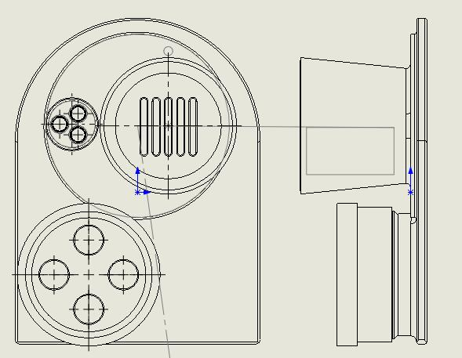
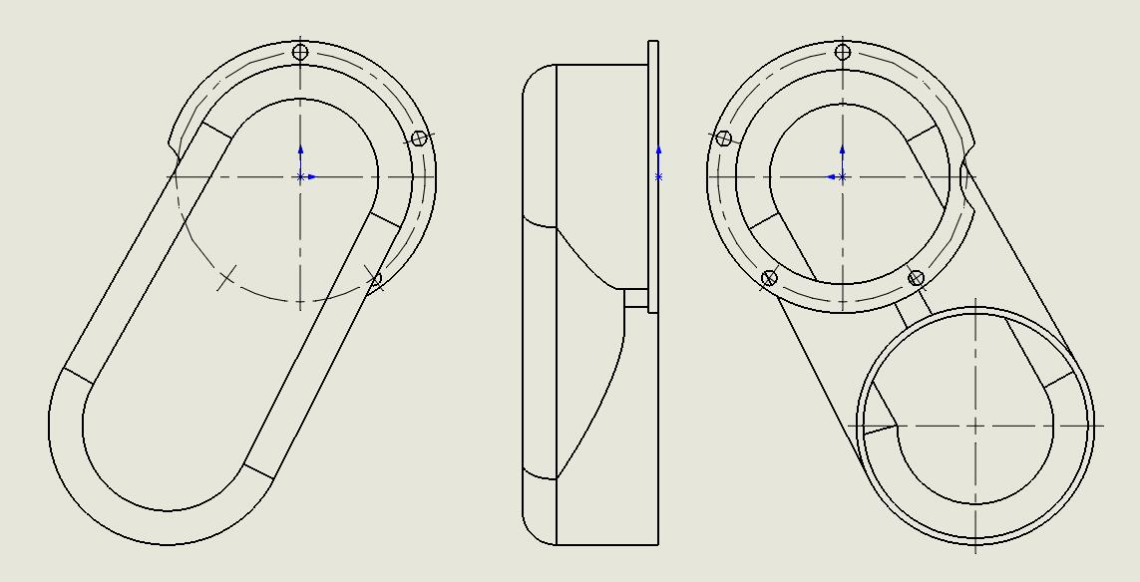
The Selected Design
Drum Size Diameter: 86mm Length: 141mm
Other Components The Air Duct: reduce the amount of copper tubes The Water Tray: exactly insert into the groove on the HX outlet The U Turn: designed to fit the Air Duct

Slide 10
Conclusion
The unique design of this dryer represents a future trend in engineering that a successful product must meet the economical, social and environmental purposes at the same time.

